Slide 1
The Influence of Typeface on Product Appeal

Slide 2
Statement of the Problem
The study was designed to determine if typeface has an affect the appeal of a product.
The reason for this study was to examine if the use of an elaborative typeface on a product will lead to higher purchasing behaviors compared to a product with a natural typeface.
If a product uses an elaborative typeface or a natural typeface, which will be preferred?

Slide 3
-Research suggests that the typeface used on a product does in fact influence what we may believe about the product itself.
-There are considerations that must be thought of when choosing a typeface for a product or brand.

Slide 4
Typeface vs. Font
Elaborative vs. Natural
Appropriateness

Slide 5
Typeface vs. Font
Typeface
Collective names of sets of fonts.
What you see
Example: Times New Roman, Comic Sans, Arial
Font
Specific member of a typeface set in a particular style
What you use

Slide 6
Typeface vs. Font
Times New Roman
Times Regular
Times Bold
Times Italic
Typeface
Font

Slide 7
Design Characteristics of Typeface
Elaborate vs. natural
Natural Typeface
More elaborate designs increase arousal
Elaborative Typeface
Complex and ornate
Organic
Natural fonts were perceived as less prominent and more subtle
Henderson,Giese, & Cote (2004)

Slide 8
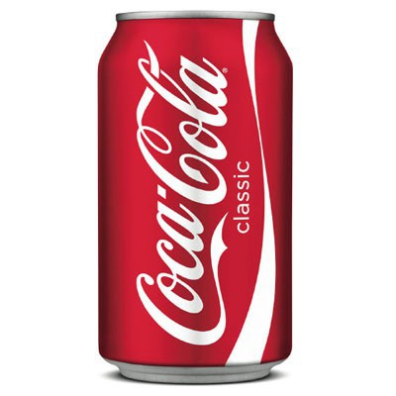
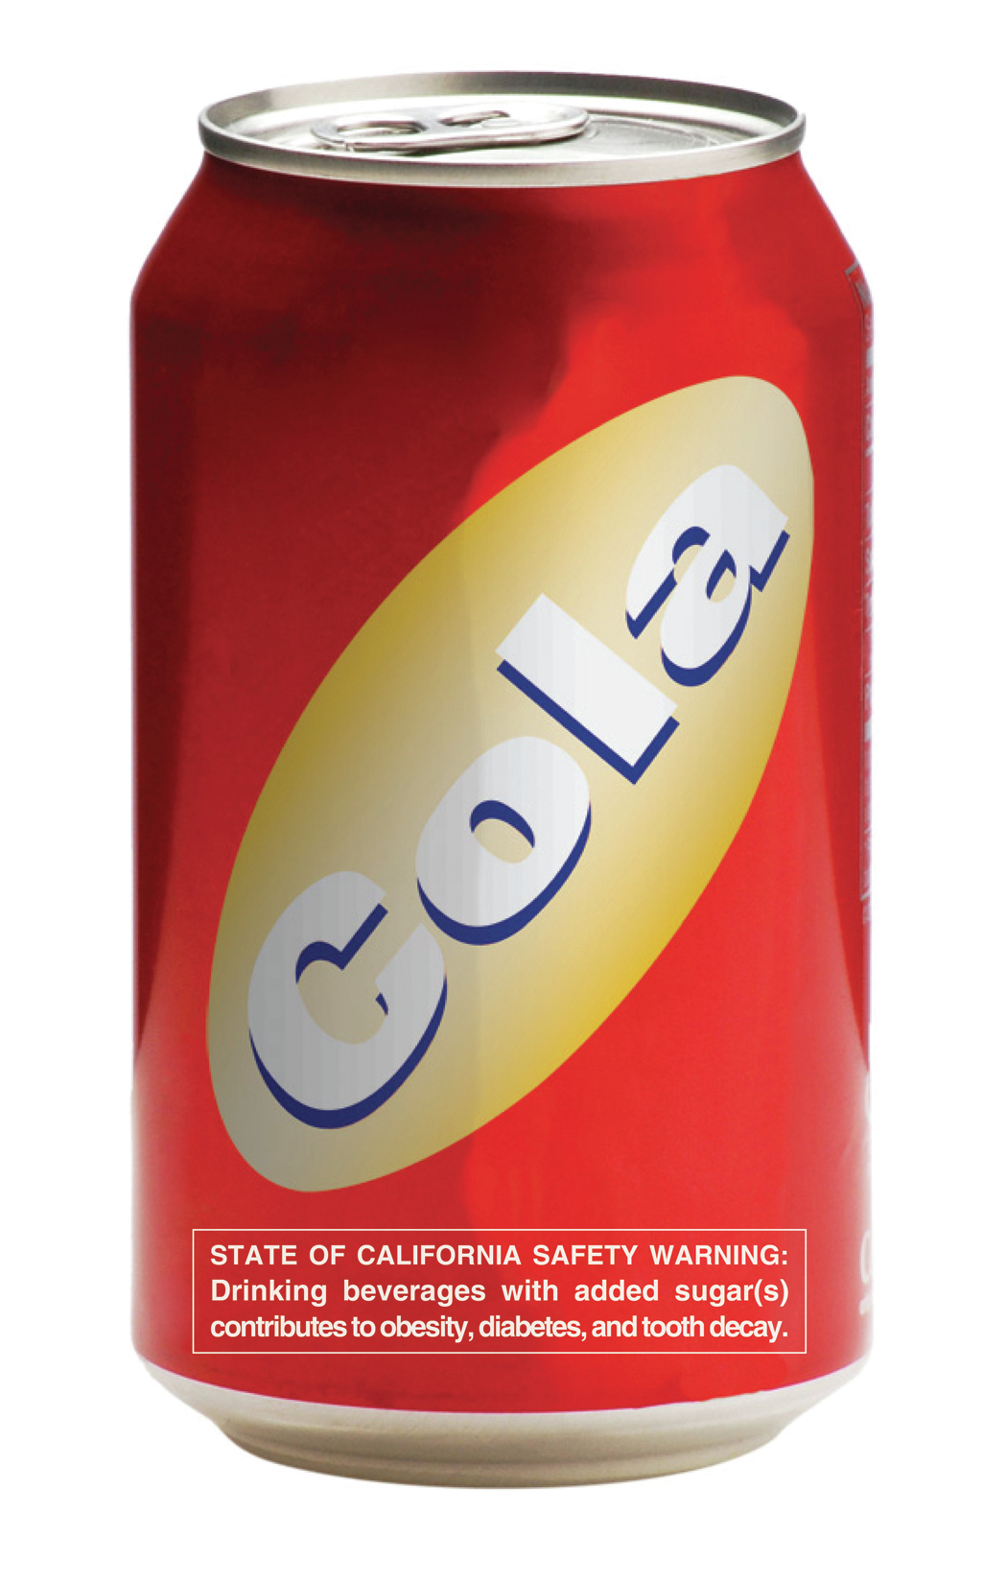
Elaborate
Natural

Slide 9
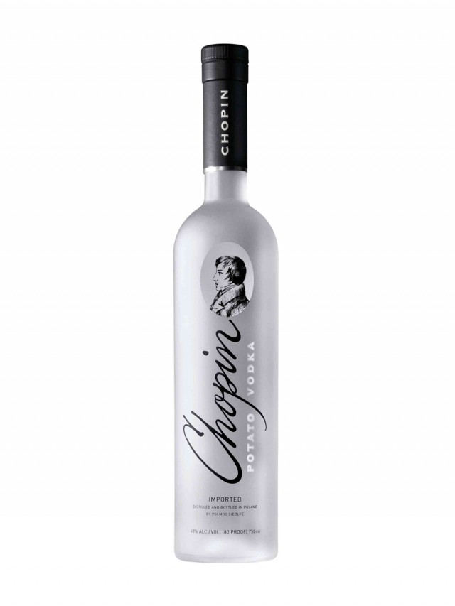
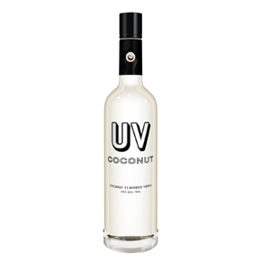
Elaborate
Natural

Slide 10
Appropriateness
Appropriate Use of Typeface
-Differing type faces do vary in appropriateness and viewers are able to ‘feel’ this appropriateness or lack of appropriateness
-It’s appropriate for products like automobiles and building material to use simple typefaces. Products like jewelry and perfume should use scripted and ornate typefaces.
Doyle, J. R., & Bottomley, P. A. (2004).

Slide 11
Appropriate Use of Typeface
Appropriateness
Hypothesis 1)
If the typeface is appropriate for the product, it will lead to a higher likelihood of purchase.
Study 1
“Brands presented in appropriate fonts were chosen more often than brands presented in inappropriate fonts (averaged over the 10 product categories, they were chosen in the ratio 2:1).” Doyle, J. R., & Bottomley, P. A. (2004).

Slide 12
Appropriateness
Appropriate Use of Typeface
Hypothesis 2) Companies that use an elaborate typeface on their product will be preferred over a product that uses a natural typeface.
Study 2
“Simple and easy-to-read fonts were associated with characteristics such as ‘cheapness’ and ‘economy’ whereas italicized, scripted, or ornate fonts were in turn associated with qualities of ‘luxury’ and ‘dignity’.” Poffenberger, A.T., Franken, R.B. (1923)

Slide 13
Methods

Slide 14
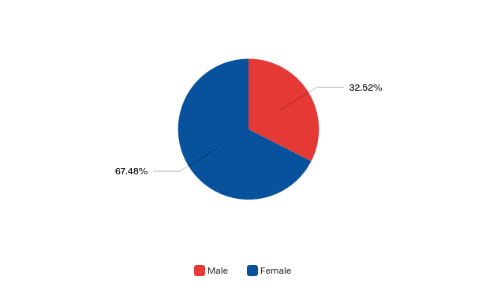
Methods: Subjects
n= 123
Male= 40 (32.52%)
Female= 83 (67.48%)
Age: 18-27

Slide 15
Methods: Design
Product Type
 | Beauty |  | Utility
 | Beauty 1 | Beauty 2 | Utility 1 | Utility 2
Elaborative | Women’s Lotion N=52 | Women’s Perfume N=52 | Bleach N=52 | Dish Soap N=52
Natural | Women’s Lotion N=56 | Women’s Perfume N=56 | Bleach N=56 | Dish Soap N=56
Typeface

Slide 16
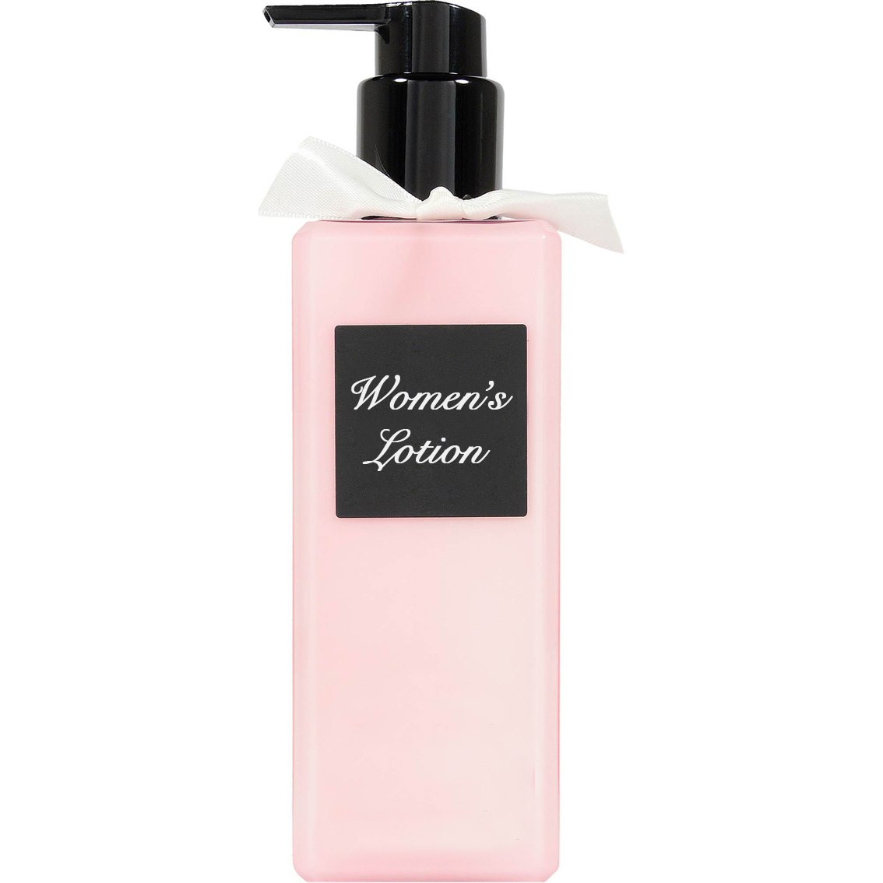
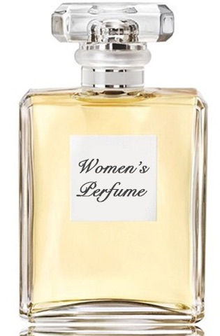
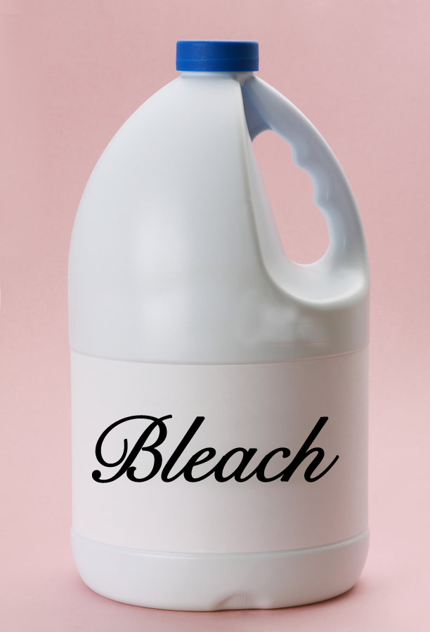
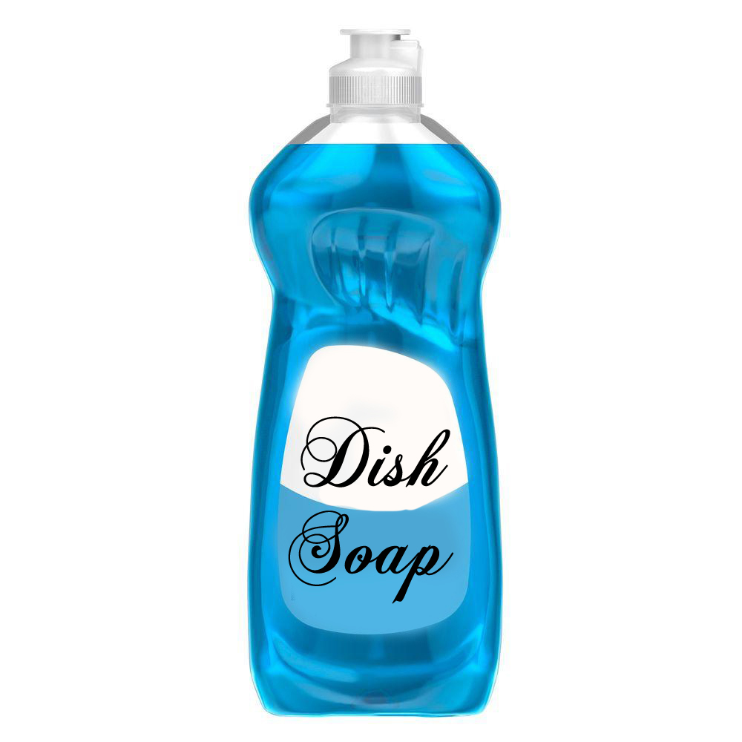
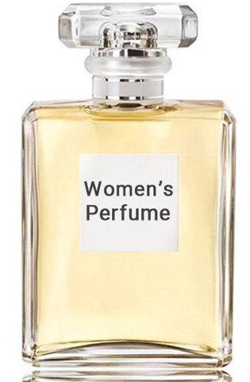
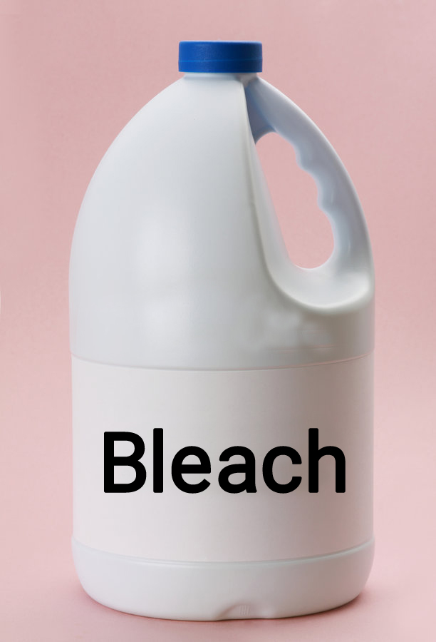
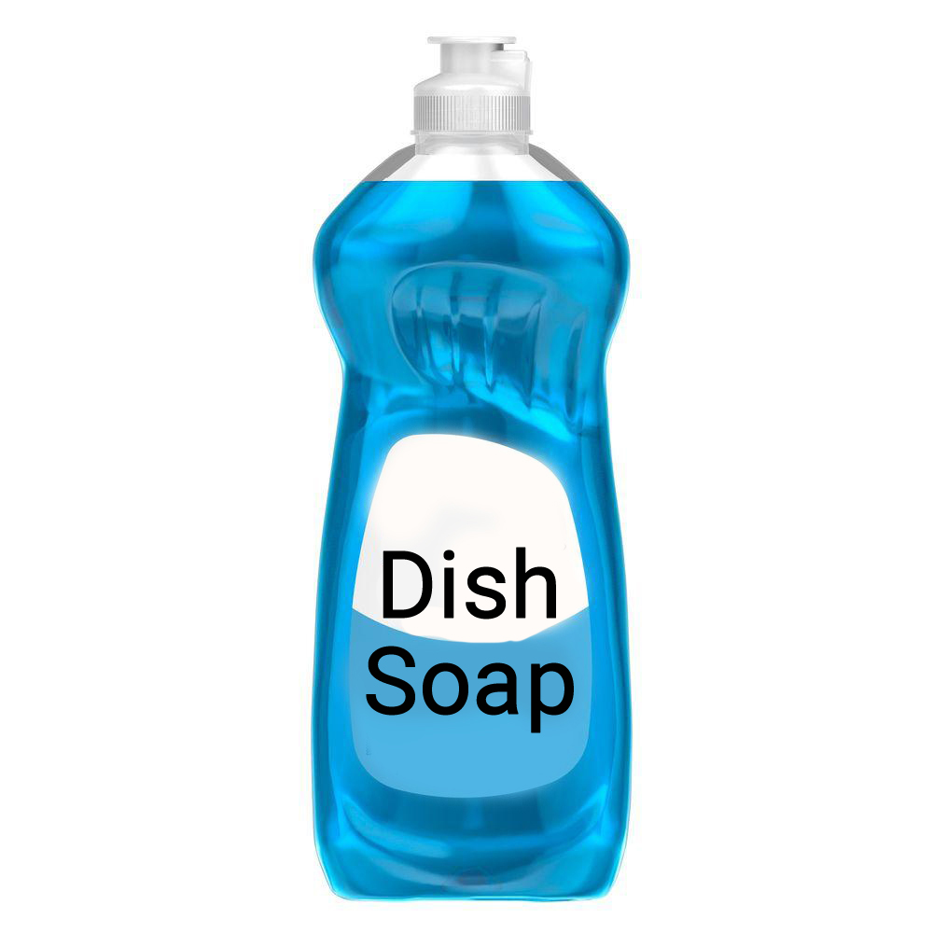
Methods: Design
Product Type
 | Beauty |  | Utility
 | Beauty 1 | Beauty 2 | Utility 1 | Utility 2
Elaborative
Natural
Typeface

Slide 17
Design: Materials
Elaborative typeface images

Slide 18
Design: Materials
Natural typeface images

Slide 19
Methods: Materials
Independent Variables
Dependent Variables
Likelihood of Purchase
Recommendation to a Friend
Estimate of Quality
Expectation of Cost

Slide 20
Results

Slide 21
Results: Likelihood of Purchase

Slide 22
Results: Likelihood of Purchase
Hypothesis
Hypothesis1) If the typeface is appropriate for the product, it will lead to a higher likelihood of purchase.
Does not support hypothesis 1
F(1,101)= .217, P<.14

Slide 23
Results: Recommendation to a Friend

Slide 24
Results: Recommendation to a Friend
Hypothesis
Hypothesis 2) Companies that use an elaborate typeface on their product will be preferred over a product that uses a natural typeface.
Does not support hypothesis 2
F(1,106)= 2.18, P< .14

Slide 25
Results: Estimate of Product Quality

Slide 26
Results: Quality of Product
Hypothesis
Hypothesis 2) Companies that use an elaborate typeface on their product will be preferred over a product that uses a natural typeface.
Does not support hypothesis 2
F(1, 109)= .249, P < .14

Slide 27
Results: Expectation of Cost

Slide 28
Results: Expectation of Cost
Hypothesis
Hypothesis 2) Companies that use an elaborate typeface on their product will be preferred over a product that uses a natural typeface.
Does not support hypothesis 2
F(1,115)= .004, P< .95

Slide 29
Results: Gender Differences

Slide 30
Results: Gender Differences
No hypothesis
Females are more likely to purchase products than men
F(1, 99)= 10.15, P> .002

Slide 31
Discussion

Slide 32
Discussion
We find that Hypotheses 1 and 2 are not supported
Found that people do not judged quality of a product based on typeface
Gender differences between purchasing behaviors

Slide 33
Limitations
Product type
Gender Specific Products
Questionnaire
Socioeconomic Background
Reverse Scales

Slide 34
Refences
Doyle, J. R., & Bottomley, P. A. (2004). Font appropriateness and brand choice. Journal of Business Research, 57(8), 873–880.
Henderson, P. W., Giese, J. L., & Cote, J. A. (2004). Impression management using typeface design. Journal Of Marketing, 68(4), 60-72. doi:10.1509/jmkg.68.4.60.42736
Poffenberger, A.T., Franken, R.B., 1923. A study of the appropriateness of typefaces. J. Appl. Psychol. 7, 312–327.
Young, Margaret Levine; Kay, David C.; Wagner, Richard (2004). WordPerfect 12 for dummies. For Dummies. p. 102.

